Slide 1
Welcome info
WiFi:
Username: conf22
Password: together!
There are gender neutral bathrooms located on the river side of the Potomac Ballroom.
The meditation room is located at Potomac Dressing Room. Open 8am - 5pm, Monday - Thursday.
The lactation room is located at National Harbor 9. Open 8am - 5pm, Monday - Thursday. The hotel also has a dedicated room behind the reception.
Participants who do not wish to be photographed have red lanyards, please note everyone's lanyard colours before taking a photo and respect their choices.
The Code of Conduct and COVID policies can be found at https://www.rstudio.com/conference/2022/2022-conf-code-of-conduct/. Please review them carefully. RStudio requires that you wear a mask that fully covers your mouth and nose at all times in all public spaces. We strongly recommend that you use a correctly fitted N95, KN95, or similar particulate filtering mask; we will have a limited supply available upon request. You can report Code of Conduct violations in person, by email, or by phone. Please see the policy linked above for contact information.

Slide 2
Clinical Reporting in R
July 2022
Christina Fillmore, Ellis Hughes, Becca Krouse, Andy Nicholls

Slide 3

Am I in the right room?

Slide 4

Hands up if you’re expecting to hear about…
R
Tidyverse
Clinical Trials
CDISC
SDTM
ADAM
Analysis Results Data (ARD)
Pharmaverse

Slide 5
What will we learn in this Workshop?
How to get from A to B using tools from the Pharmaverse
The potential power of Analysis Results Data to transform your workflows
This will include:
SDTM to ADaM conversion with {admiral} and {metatools}
Generating Analysis Results Data with {Tplyr}
Generating submission-ready tables with {tfrmt} and {gt}
Generating mock data and tables

Slide 6

Expectations
Notes:
We’re going to go far. We’ll get from A to B, but we’re doing so on a bike.
This stuff isn’t ready yet. It’s not fully tested

Slide 7
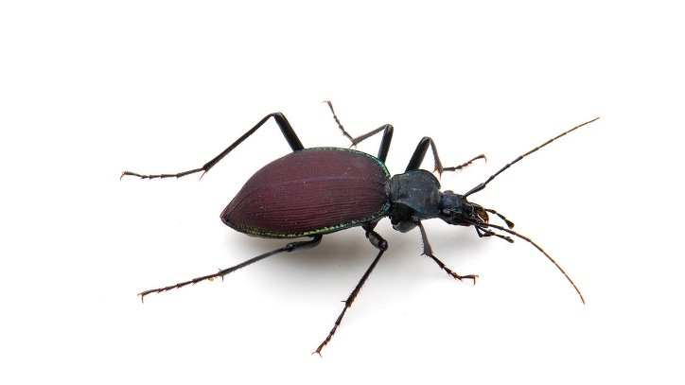
What to expect
To learn about some new packages
Hands-on exercises
Candy!
But also,
Don’t forget to tell us about these!

Slide 8

What will we not be talking about
Validation/qualification – See https://www.pharmar.org/

Slide 9
Stick Notes
Exercises
I’m done with this exercise
Help!

Slide 10
Stick Notes
Feedback
Something positive that I’ve seen / learned
Something I didn’t like / wasn’t useful

Slide 11
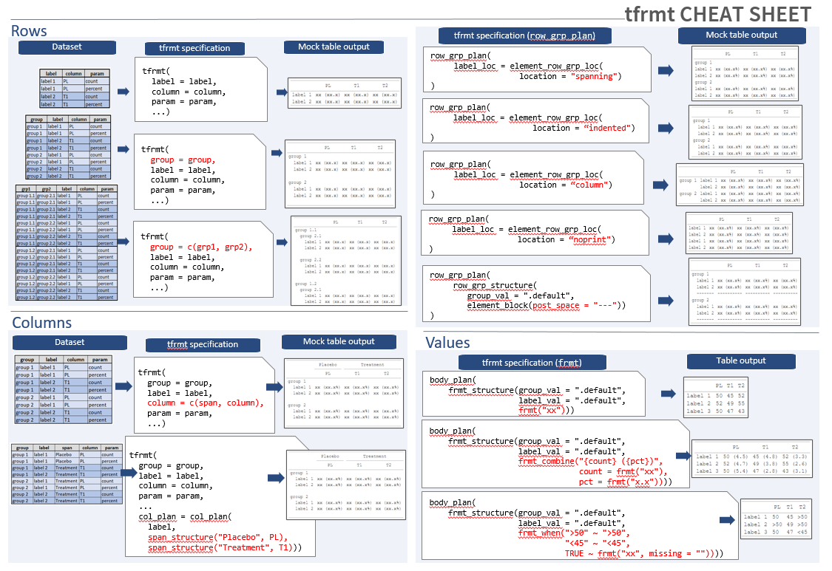
Handouts

Slide 12

Introductions

Slide 13




Introductions
Who are you?
What do you do?
Who do you do it for?
What are you hoping to get out of this workshop?
Andy Nicholls
Christina Fillmore
Becca Krouse
Ellis Hughes

Slide 14


Don’t go getting that package name wrong!
We’re going to introduce lots of new package names
You’re going to get them wrong
We’re going to get them wrong
Each time we do, call us out and earn a sweet candy!
= “T format”
!= “tlang”
Former working tittle
Notes:
We’re going to introduce lots of new package names
You’re going to get them wrong
*we’re* going to get them wrong
Each time we do, call us out and earn a sweet

Slide 15

We’re starting with some orientation
Notes:
This is the only thing that matters right now.
First let’s look at what we do and frame the problem

Slide 16
Coffee break @ 10:30m
Notes:
This is the only thing that matters right now.
First let’s look at what we do and frame the problem

Slide 17

Let’s get coding…
Notes:
Imagine this is R code, not HTML!

Slide 18

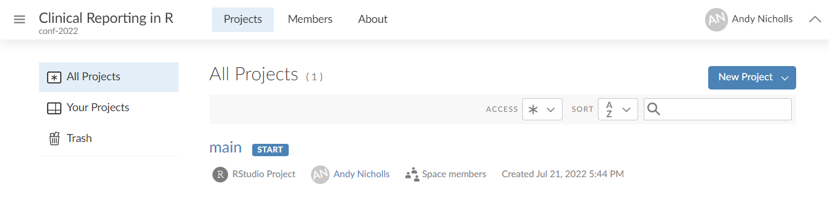
Our environment
For consistency, we’ll be working in RStudio Cloud
We’ve installed and configured everything for you
Following the course please visit GitHub for the environment installation script, examples and exercises

Slide 19
Stick Notes
Exercises
I’m done with this exercise
Help!

Slide 20
Exercise 1
Analysing Data
Start your project
Open exercise 1 ("exercises/exercise1.R")
Using haven, read in the ADSL ("/datasets/ADAM/ADSL") and ADAE data ("/datasets/ADAM/ADAE")
Using the {tidyverse}
Use ADSL to calculate “Big N” for each treatment (TRT01A)
Generate counts of distinct subject (USUBJID) AE’s by system organ class (AEBODSYS) and reported term (AETERM), and by treatment (TRT01A)
Merge on/join the Big N values and calculate percentages (pct) of each reported term by system organ class and treatment

Slide 21
Exercise 1b
Analysing Data
Now format your data from exercises 1 such that
The n and percentage are displayed as " [n] ([pct]%)"
The first percentage brace is aligned for each value
Blanks ("") are displayed instead of " 0 (0%)"
How much more would we learn about our data?
Notes:
People should NOT ACTUALLY DO THIS
It is to illustrate that there’s a load of work to do that doesn’t add value

Slide 22
We’re getting there…
Notes:
This is the only thing that matters right now.
First let’s look at what we do and frame the problem

Slide 23
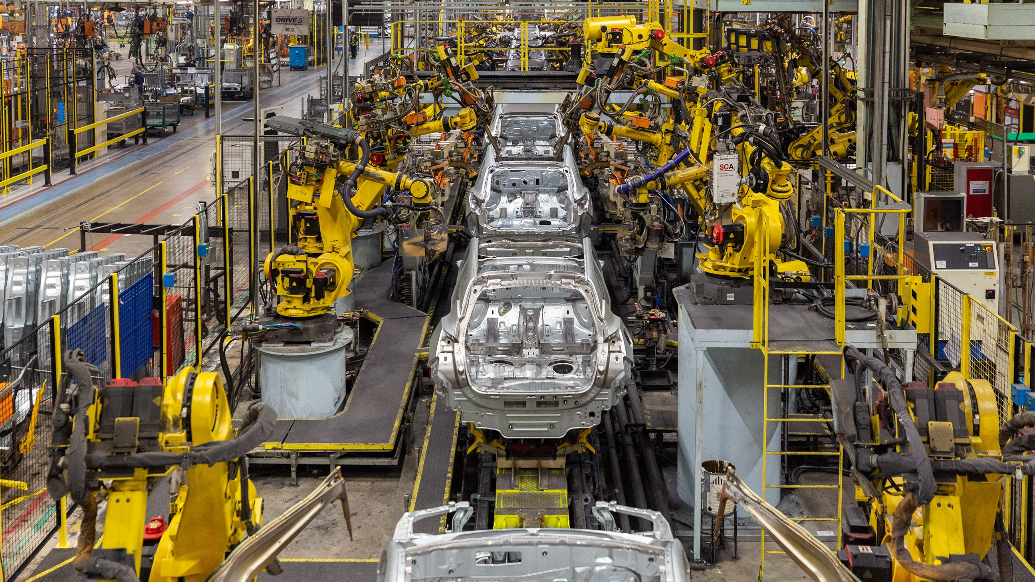
What do we do?
Notes:
Delivering a clinical study is a production line.
But what is it that we actually do?
Where do we add value?
Ask audience
Point being that we do the analysis, but we spend all our time formatting tables.
Wouldn’t it be great if we could focus on the analysis?

Slide 24





Roadmap
Mocks
Plan
ADaMs
Outputs
Notes:
Christina is less optimistic than Andy so we’re hiking rather than taking a bike!
Clinical trails are a journey that can take many months if not years to complete
But from experience we know we can accomplish this task all in one day, but instead have way point, like a camper doesn’t try to hike long distances all at once, but will stop and make camp
At the moment we stop here, but that leaves a gap between the ADaMs and the output. The problems with having a gap here are:
it means when we are doing analysis we also have to be doing formatting (so we QC formatting as well which is a waste of time)
Analysis can’t be reused in metanalysis
Formatting changes can’t be made without rerunning/qcing the analysis
In comes ARDs

Slide 25
Exercise
What do we do?
What are the outputs when reporting a clinical study?
SDTM data
ADaM data
Submission TLFs
…

Slide 26
Roadmap
Mocks
ARDs
Plan
ADaMs
Outputs
Notes:
Clinical trails are a journey that can take many months if not years to complete
But from experience we know we can accomplish this task all in one day, but instead have way point, like a camper doesn’t try to hike long distances all at once, but will stop and make camp
At the moment we stop here, but that leaves a gap between the ADaMs and the output. The problems with having a gap here are:
it means when we are doing analysis we also have to be doing formatting (so we QC formatting as well which is a waste of time)
Analysis can’t be reused in metanalysis
Formatting changes can’t be made without rerunning/qcing the analysis
In comes ARDs

Slide 27

Analysis Results Data
The Possibilities
Data Analysis
ADaM
Analysis Results Data

Slide 28
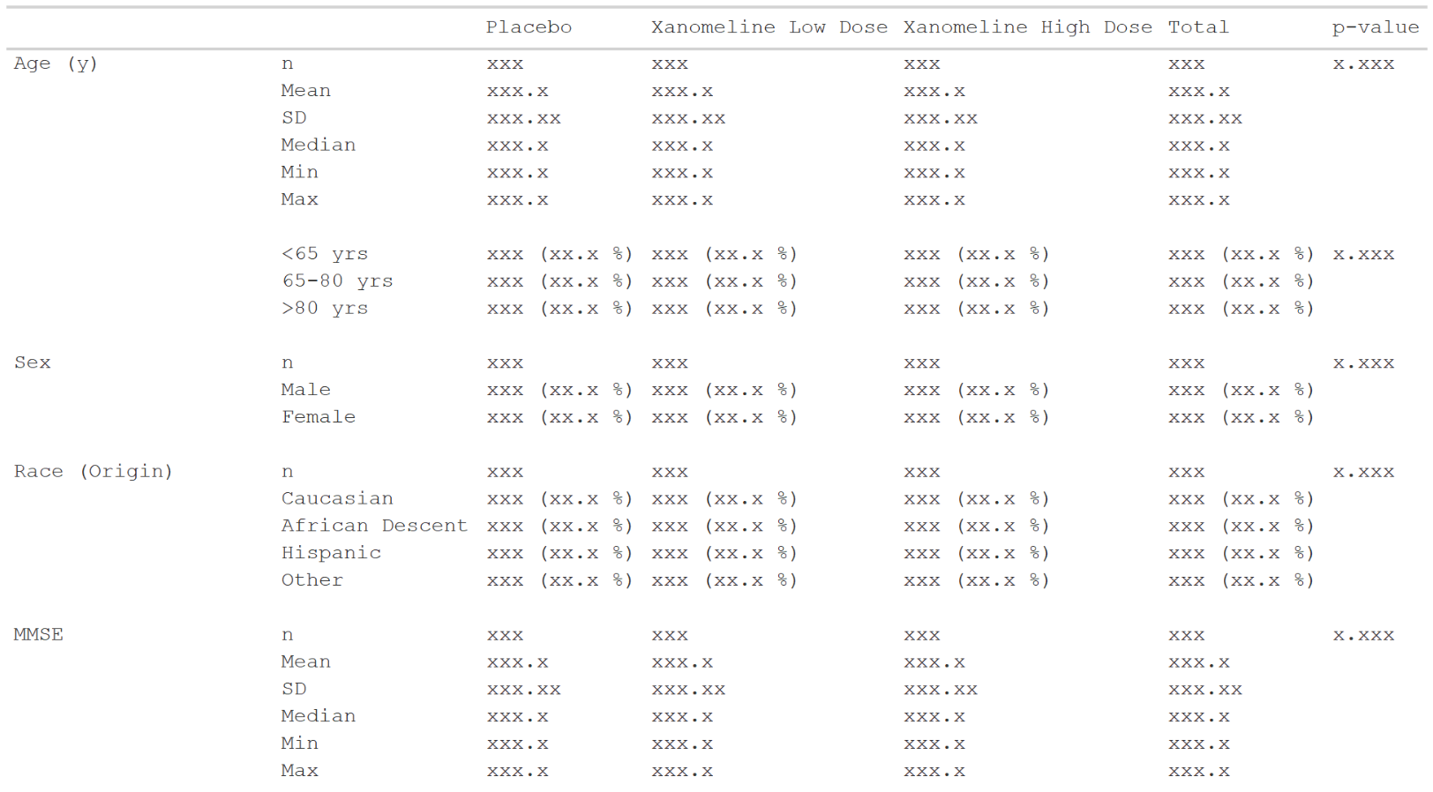
Analysis Results Data
The Possibilities
Submissions
Data Analysis
ADaM
Analysis Results Data

Slide 29
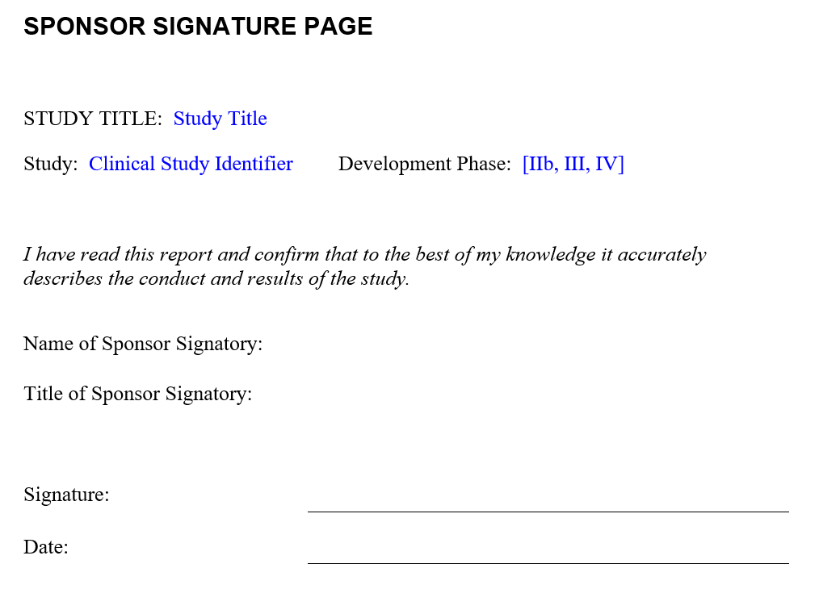
Analysis Results Data
The Possibilities
In-text CSR
Submissions
Data Analysis
ADaM
Analysis Results Data

Slide 30

Analysis Results Data
The Possibilities
In-text CSR
Presentations
Submissions
Data Analysis
ADaM
Analysis Results Data

Slide 31

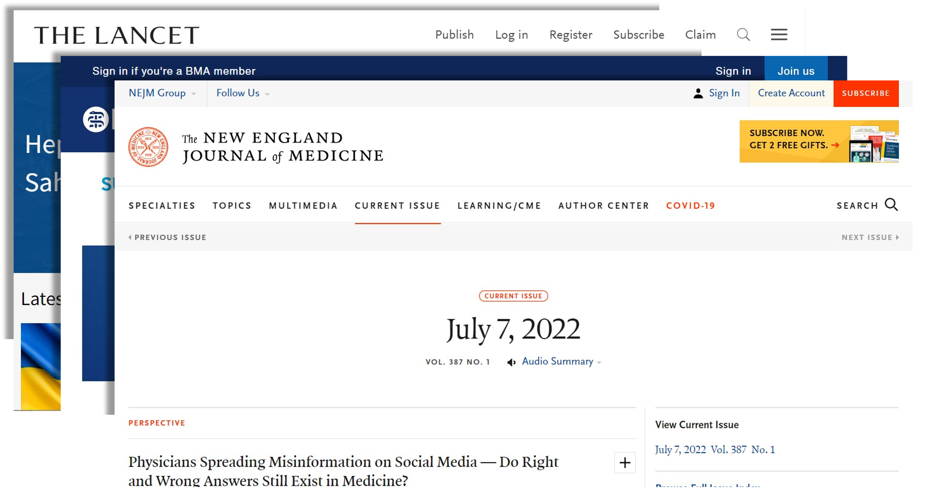
Analysis Results Data
The Possibilities
In-text CSR
Presentations
Submissions
Publications
Data Analysis
ADaM
Analysis Results Data

Slide 32
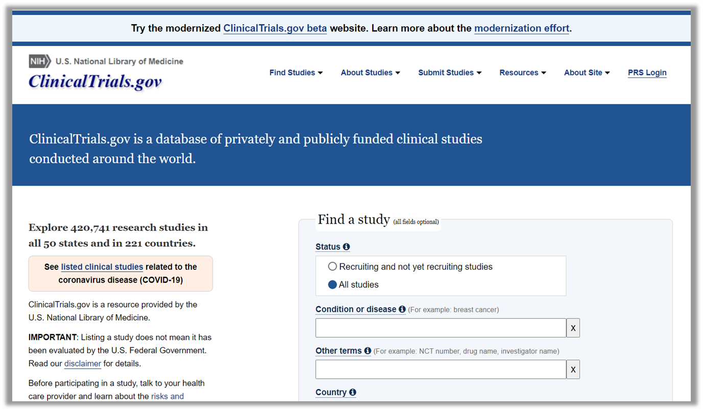

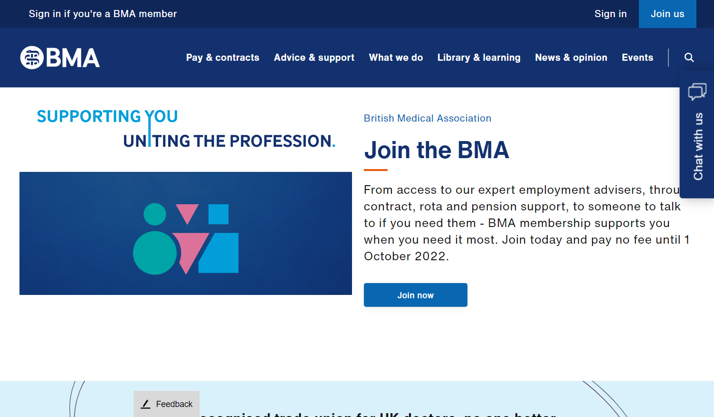
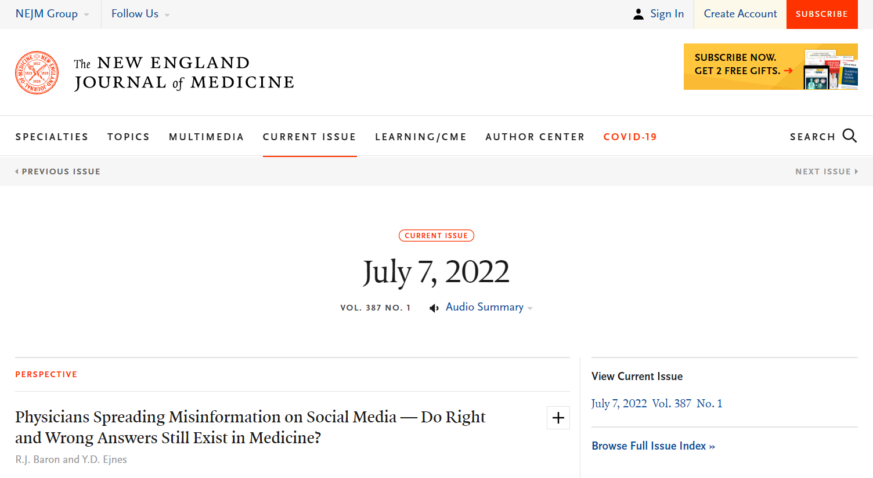
Analysis Results Data
The Possibilities
In-text CSR
Presentations
Submissions
Publications
Data Analysis
ADaM
Analysis Results Data
clinicaltrials.gov

Slide 33
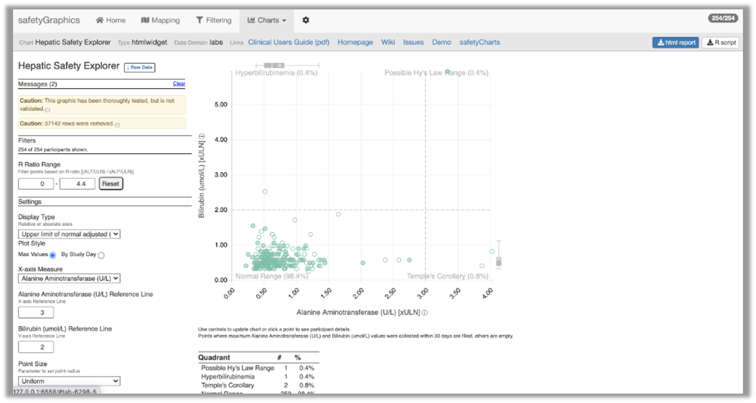
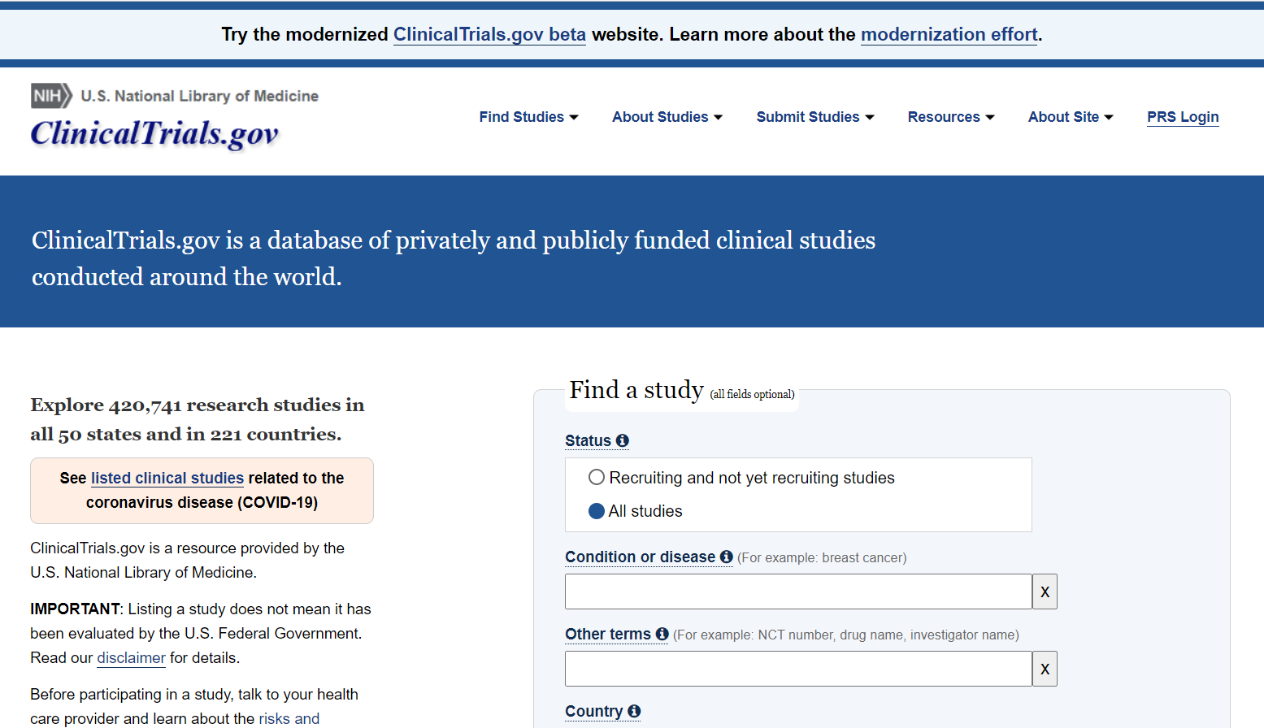
Analysis Results Data
The Possibilities
In-text CSR
Presentations
Submissions
Publications
Data Analysis
ADaM
Analysis Results Data
clinicaltrials.gov
Dynamic apps

Slide 34
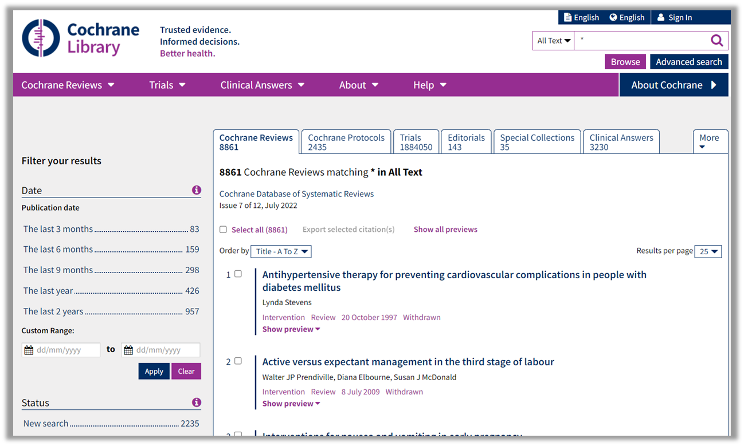
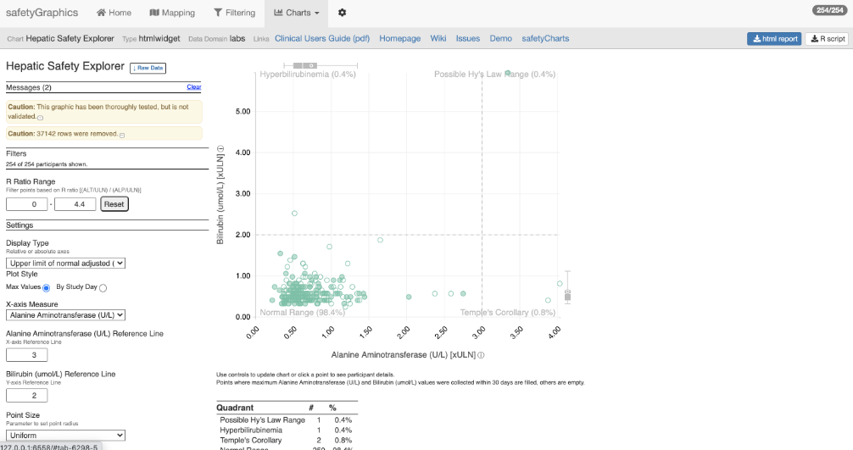
Analysis Results Data
The Possibilities
In-text CSR
Presentations
Submissions
Publications
Data Analysis
ADaM
Analysis Results Data
clinicaltrials.gov
Dynamic apps
Meta-analyses

Slide 35
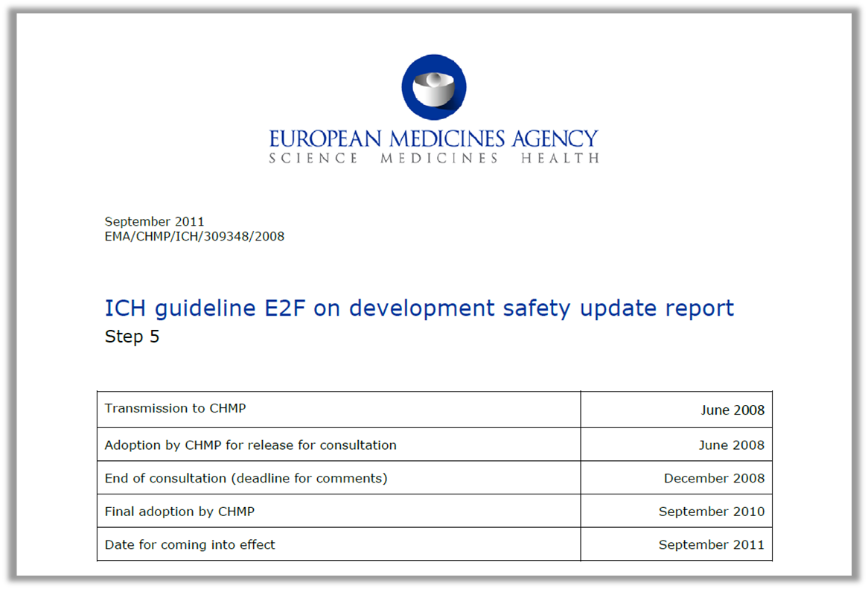
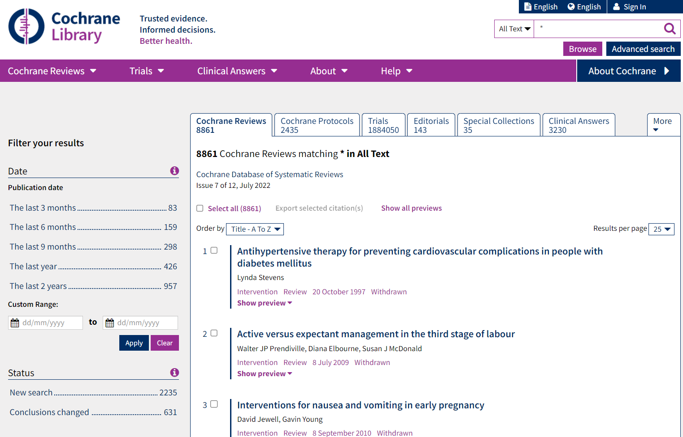
Analysis Results Data
The Possibilities
In-text CSR
Presentations
Submissions
Publications
Data Analysis
ADaM
Analysis Results Data
clinicaltrials.gov
Integrated safety reporting
Dynamic apps
Meta-analyses

Slide 36

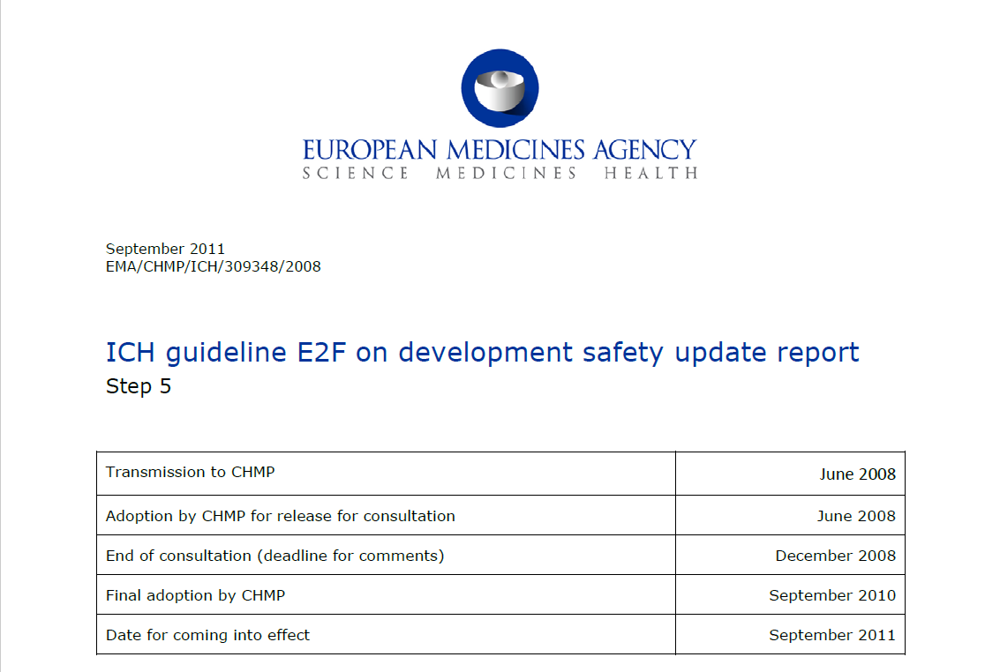
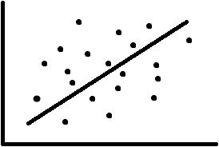
Analysis Results Data
The Possibilities
In-text CSR
Presentations
Submissions
Publications
Data Analysis
ADaM
Analysis Results Data
clinicaltrials.gov
In future, graphics?
Integrated safety reporting
Dynamic apps
Meta-analyses
Analysis
Formatting

Slide 37
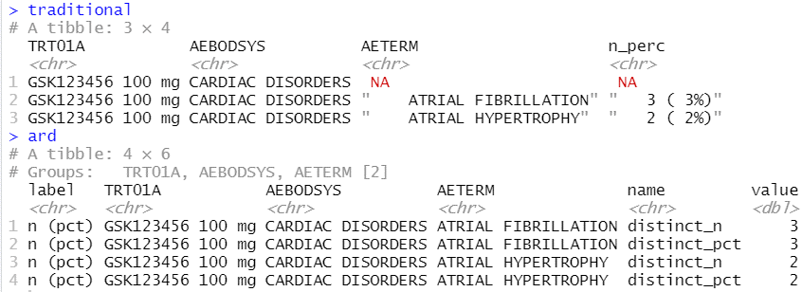
Analysis Results Data
Key features
Unformatted values
1 value per row
Distinct columns for each grouping variable
Include everything you want to display (particularly labels)
Interested in reading more, see:
Why we should respect analysis results as data
Why we should respect analysis results as data
Joana M Barros, Lukas A Widmer, Mark Baillie, Simon Wandel, (Analytics, Novartis Pharma AG, Basel, Switzerland)
https://doi.org/10.48550/arXiv.2204.09959

Slide 38
Roadmap
Mocks
ARDs
Plan
ADaMs
Outputs
Notes:
Clinical trails are a journey that can take many months if not years to complete
But from experience we know we can accomplish this task all in one day, but instead have way point, like a camper doesn’t try to hike long distances all at once, but will stop and make camp
At the moment we stop here, but that leaves a gap between the ADaMs and the output. The problems with having a gap here are:
it means when we are doing analysis we also have to be doing formatting (so we QC formatting as well which is a waste of time)
Analysis can’t be reused in metanalysis
Formatting changes can’t be made without rerunning/qcing the analysis
In comes ARDs

Slide 39
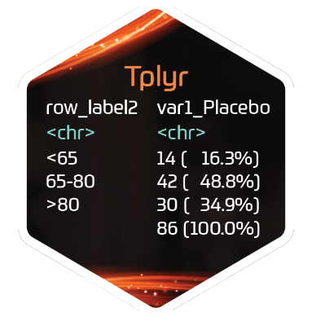



Roadmap – pharmaverse
Mocks
ARDs
Plan
ADaMs
Outputs
Notes:
There currently exists packages to help us on our journey, we go we will uncover each

Slide 40
The actual agenda this time!
Notes:
Andy stops here

Slide 41
Plan for this workshop
Day 1
Day 2
Create mocks for:
AE Table
PFTs Summary
Stats Analysis
Create ARDs for:
AE Table
PFTs Summary
Stats Analysis
Mocks
ARDs
Plan
ADaMs
Outputs
Create ADaMs for:
ADSL
ADAE
Create displays for:
AE Table
PFTs Summary
Stats Analysis
Import metadata into R

Slide 42
Study Information
Phase 2B
Respiratory study, with change in FEV1 as the primary endpoint
Visits at:
Screening
Baseline
Week 4
Week 8
Week 12
200 subjects
100 per arm
Dataset specification can be found at:
specs/specs.xls

Slide 43
Map
Create mocks for:
AE Table
PFTs Summary
Stats Analysis
Mocks
ARDs
Plan
ADaMs
Outputs

Slide 44

{tfrmt}
General Purpose:
Building tables from ARDs based on metadata
Lifecycle:
Alpha release is out. Will likely go to CRAN by the end of the year once additional functionality is added
Common Functions:
tfrmt()
Setup a table
body_plan()
Defines the body of the table
frmt_structure()
Defines which rows to apply formatting to
frmt_combine()/frmt_when()/frmt()
Defines the formatting
col_plan()
Sets column appearance
row_grp_plan()
Defines the style for each group
print_mock_gt()
Prints to gt without data to produce a mock
print_to_gt()
Prints to gt with data to make final table
https://gsk-biostatistics.github.io/tfrmt/

Slide 45


tfrmt process flow
Create a mock based on metadata
Define table metadata
Format values in accordance with metadata
ARD
Notes:
Why gt:
From Rstudio so a reputable source
Good functionality to go out to where we need to
Ect.

Slide 46
Tables parts
 |  | Placebo (N = XX) | Treatment (N = XX) | Total (N = XX)
Age (y) | n | XX | XX | XX
 | Mean (sd) | XX.X(XX.XX) | XX.X(XX.XX) | XX.X(XX.XX)
 | Median | XX.X | XX.X | XX.X
 | Min, Max | XX,XX | XX,XX | XX,XX
 | <65 yrs | XX (XX.X%) | XX (XX.X%) | XX (XX.X%)
 | 65-80 yrs | XX (XX.X%) | XX (XX.X%) | XX (XX.X%)
 | >80 yrs | XX (XX.X%) | XX (XX.X%) | XX (XX.X%)
Sex | n | XX | XX | XX
 | Male | XX (XX.X%) | XX (XX.X%) | XX (XX.X%)
 | Female | XX (XX.X%) | XX (XX.X%) | XX (XX.X%)
Columns
Row groups
Labels and groups
Table body
Notes:
How can we break a table down into component parts

Slide 47
Tables parts
 |  | Placebo (N = XX) | Treatment (N = XX) | Total (N = XX)
Age (y) | n | XX | XX | XX
 | Mean (sd) | XX.X(XX.XX) | XX.X(XX.XX) | XX.X(XX.XX)
 | Median | XX.X | XX.X | XX.X
 | Min, Max | XX,XX | XX,XX | XX,XX
 | <65 yrs | XX (XX.X%) | XX (XX.X%) | XX (XX.X%)
 | 65-80 yrs | XX (XX.X%) | XX (XX.X%) | XX (XX.X%)
 | >80 yrs | XX (XX.X%) | XX (XX.X%) | XX (XX.X%)
Sex | n | XX | XX | XX
 | Male | XX (XX.X%) | XX (XX.X%) | XX (XX.X%)
 | Female | XX (XX.X%) | XX (XX.X%) | XX (XX.X%)
tfrmt(…,
group = “var1”,
label = “var2”,
body_plan = body_plan(),
col_plan = col_plan(),
row_grp_plan = row_grp_plan()
)
Notes:
Tfrmt works by letting you set the styling of each component part

Slide 48
tfrmt with Analysis Results Data
Group | Label | Column | Param | Value
Age (y) | n | Placebo | n | 15.00
Age (y) | n | Treatment | n | 13.00
Age (y) | n | Total | n | 28.00
Sex | n | Placebo | n | 14.00
Sex | n | Treatment | n | 13.00
Sex | n | Total | n | 27.00
Age (y) | Mean (sd) | Placebo | mean | 73.56
Age (y) | Mean (sd) | Treatment | mean | 74.231
Age (y) | Mean (sd) | Total | mean | 71.84
Age (y) | Mean (sd) | Placebo | SD | 9.347
Age (y) | Mean (sd) | Treatment | SD | 7.234
Age (y) | Mean (sd) | Total | SD | 8.293
tfrmt(
group = Group,
label = Label,
column = Column,
values = Value,
param = Param,
…
)
 |  | Placebo | Treatment | Total
Age (y) | n | 15 | 13 | 28
 | Mean (sd) | 73.6(9.35) | 74.2(7.23) | 71.8(8.29)
Sex | n | 14 | 13 | 27
 | Male | 8 (57.1%) | 7 (53.8%) | 15 (55.6%)
 | Female | 6 (48.2%) | 6 (46.1%) | 12 (44.4%)
Notes:
Parameters allow you to combine elements and create conditional formatting for values with the same label

Slide 49
Value formatting
body_plan(
frmt_structure(
group_val = ".default",
label_val = ".default",
frmt_combine("{n} ({pct}%)",
n = frmt("X"),
pct = frmt("xx.x")
)
),
frmt_structure(
group_val = ".default",
label_val = "n",
frmt("XX")),
frmt_structure(
group_val = "Age (y)",
label_val = "Mean (sd)",
frmt_combine("{mean}({SD})",
mean = frmt("XX.X"),
SD = frmt("x.xx")
)
)
)
Group | Label | Column | Param | Value
Age (y) | n | Placebo | n | 15.00
Age (y) | n | Treatment | n | 13.00
Age (y) | n | Total | n | 28.00
Sex | n | Placebo | n | 14.00
Sex | n | Treatment | n | 13.00
Sex | n | Total | n | 27.00
Age (y) | Mean (sd) | Placebo | mean | 73.56
Age (y) | Mean (sd) | Treatment | mean | 74.231
Age (y) | Mean (sd) | Total | mean | 71.84
Age (y) | Mean (sd) | Placebo | SD | 9.347
Age (y) | Mean (sd) | Treatment | SD | 7.234
Age (y) | Mean (sd) | Total | SD | 8.293
 |  | Placebo | Treatment | Total
Age (y) | n | 15 | 13 | 28
 | Mean (sd) | 73.6(9.35) | 74.2(7.23) | 71.8(8.29)
Sex | n | 14 | 13 | 27
 | Male | 8 (57.1%) | 7 (53.8%) | 15 (55.6%)
 | Female | 6 (48.2%) | 6 (46.1%) | 12 (44.4%)

Slide 50
{tfrmt}
General Purpose:
Building tables from ARDs based on metadata
Lifecycle:
Alpha release is out. Will likely go to CRAN by the end of the year once additional functionality is added
Common Functions:
tfrmt()
Setup a table
body_plan()
Defines the body of the table
frmt_structure()
Defines which rows to apply formatting to
frmt_combine()/frmt_when()/frmt()
Defines the formatting
col_plan()
Sets column appearance
row_grp_plan()
Defines the style for each group
print_mock_gt()
Prints to gt without data to produce a mock
print_to_gt()
Prints to gt with data to make final table
https://gsk-biostatistics.github.io/tfrmt/

Slide 51

Demo time
Notes:
Walk through a metadata example
Also talk about layerings with templates

Slide 52
Exercise 2: Making Mock Shells
Using the `tfrmt_n_pct()` template included in {tfrmt}, create the foundation of a tfrmt for an AE table and print it. The AE mock should have treatment across the top with AEs going vertically.
Modify the tfrmt from (A) by adding the system organ class ("bodysys") and preferred term ("ae_term") as `group` and `label` to create nesting like most AE tables. Print the updated tfrmt to preview the new mock shell.
BONUS: By default, the tfrmt displays system organ class as a row spanner label. Modify the tfrmt to indent the preferred terms under the system organ classes in a single column. (hint: look at the `row_grp_plan` function). Print the updated tfrmt to preview the new mock shell
EXTRA BONUS: Create a dataset containing a few sample body systems and AE terms to supply to `print_mock_gt`. The dataset will need a column for system organ class ("bodysys"), preferred term ("ae_term"), treatment (column variable), and parameter (param variable). The tfrmt from (B) may need to be updated to include the column and param variables.

Slide 53
Stick Notes
Feedback
Something positive that I’ve seen / learned
Something I didn’t like / wasn’t useful

Slide 54
Exercise 3
Create a mock shell for Summary for of PFTs (Pulmonary Function Test) by Visit
Using `param_set`, update the defaults so the min/max and q1/q3 parameters will presented together on the same line (separated by a comma). Min and max have +0 rounding and the quantiles have +1 rounding. Also add missing.
Using the set of parameters from (i) create a tfrmt using `tfrmt_sigdig()` and the `sigdig_df` data. The `group` and `label` argument inputs should take column names from `data`.
Add another tfrmt layer to (ii) to add the names of the `column` and `param` columns that match the given data. Also use the `row_grp_plan` to indent the grouping and label columns. Print this mock with `data`.
Finally, supply the sorting columns to `sorting_cols` and use `col_plan` to drop them from the table. Print this mock with `data`.
Create a mock shell for the primary analysis of FEV1.
Using the partially completed tfrmt, add formatting for the confidence intervals (conf.low, conf.high) and p-values (p.value). Then print the mock using the `data`
Using col_plan fix the column order so it is GSK123456, Placebo and then the difference. Also, drop the order column. Print this mock with `data`.
Change the group location from spanning to indented. Print this mock with `data`.

Slide 55

Map
Mocks
ARDs
Plan
ADaMs
Outputs
Create ADaMs for:
ADSL
ADAE
Import metadata into R

Slide 56

CDISC Warning

Slide 57





Building ADaMs process flow
Import metadata
Combine predecessor variables
Do any calculations
Drop unused variables
Import data
Export dataset
Notes:
Can be done, just using the tidyverse, but it requires a bit more work

Slide 58
{metacore}
General Purpose:
Holds the metadata used to build SDTM and ADaM datasets
Lifecycle:
It is on CRAN and has been around for ~1.5 years. Fairly stable, but will change with CDISC standards
Common Functions:
spec_to_metacore()
Reads a P21 spec into metacore
select_dataset()
Select a single dataset of metadata
get_control_term()
Pulls out the control terms for a variable
https://atorus-research.github.io/metacore/

Slide 59
{metatools}
General Purpose:
Automating dataset creation based on the {metacore}
Lifecycle:
It is on CRAN and has been around for ~1 year. Fairly stable, but new features are still being added
Common Functions:
build_from_derived()
Builds a dataset based on all predecessors
combine_supp()
Combines supps and domains
create_var_from_codelist()
Creates a new variable based on code/decode
create_cat_var()
Creates a categorial variable from continues based on codelist
order_cols()
Orders the columns per metadata definitions
set_variable_labels()
Adds labels to all columns per metadata definitions
check_ct_data()
Checks all values fall within control terms
pharmaverse.github.io/metatools/

Slide 60
{admiral}
General Purpose:
Functions to do common ADaM calculations
Lifecycle:
It is on CRAN and has been around for ~1.5 years. Some functions are still being sorted out
Common Functions:
derive_vars_merged_dtm()
Merge and impute datetime variables
derive_var_merged_exist_flag()
Merge an existing flag
compute_bmi()
Computes BMI
derive_var_base()
Creates a baseline column from flag
https://pharmaverse.github.io/admiral/

Slide 61

Demo time
Notes:
Go through each set in the process flow. Also open specs

Slide 62
Exercise 4 : SDTM to ADaM data
Following the creation of the other variables in `adsl_decode`, use the specifications to make the ACOUNTRY and RACEN.
Add baseline values for height, weight and BMI to adsl (should be called HEIGHTBL, WEIGHTBL, and BMIBL respectively). These values should be extracted and calculated from the `vs` dataset where `VSBLFL` is "Y" and added to the `adsl_decode` dataset to make `adsl_bl`
Create a safety flag. "Y" for all subject who received a dose or who were on placebo. This can be derived from the `ex` dataset where the participants have either an exposure (`EXDOSE` > 0) or are placebo. Add this to the code for `adsl_ex` to create `adsl`.
BONUS: Make `ADAE` by first pulling together the predecessors, and then making `ASTDT` and `AENDT` by extracting the date from `AESTDTC` and `AEENDTC` respectively

Slide 63
Map
Mocks
ARDs
Plan
ADaMs
Outputs
Create ADaMs for:
ADSL
ADAE
Import metadata into R

Slide 64
Stick Notes
Feedback
Something positive that I’ve seen / learned
Something I didn’t like / wasn’t useful

